Slide 1

Chris Shenton
@shentonfreude
NASA Science Mission Directorate
chris.shenton@nasa.gov
Notes:
Browser-based calculations and 3D visualization.

Slide 2
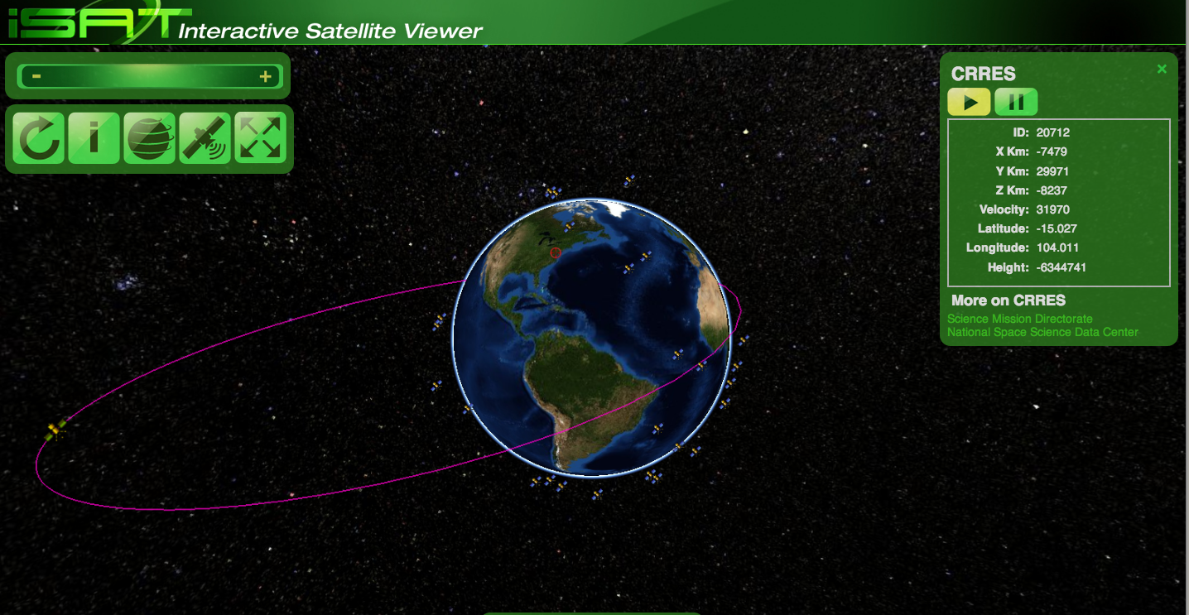
Notes:
Overview:
Background and history
How it’s built, and why
Demos in action

Slide 3
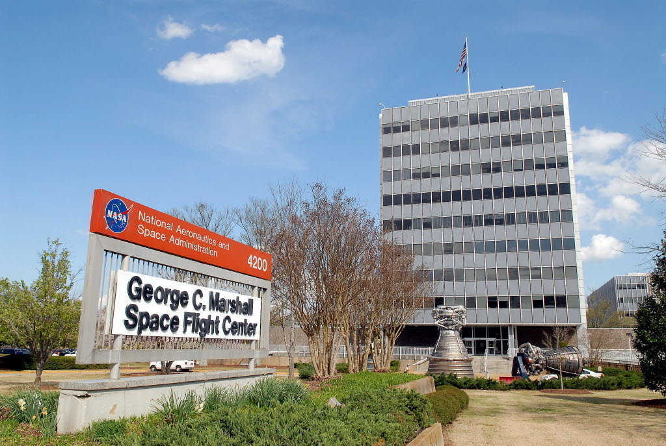
1990s: Patrick Meyer
Notes:
In the 1990s, Patrick Meyer at NASA MSFC was working on Fortran and Java code to track satellites.
http://www.nasasolutions.com/software-catalog/MFS-32013-1-J-Track.php

Slide 4
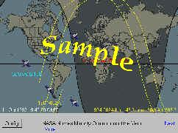
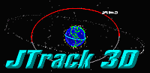
1997: J-Track
1998: J-Track 3D
Requires 166 MHz CPU !
Notes:
1997: J-Track,
1998: J-Track 3D. It required a 166 MHz CPU
Implemented as a Java applet, run by the browser (not on the server)

Slide 5

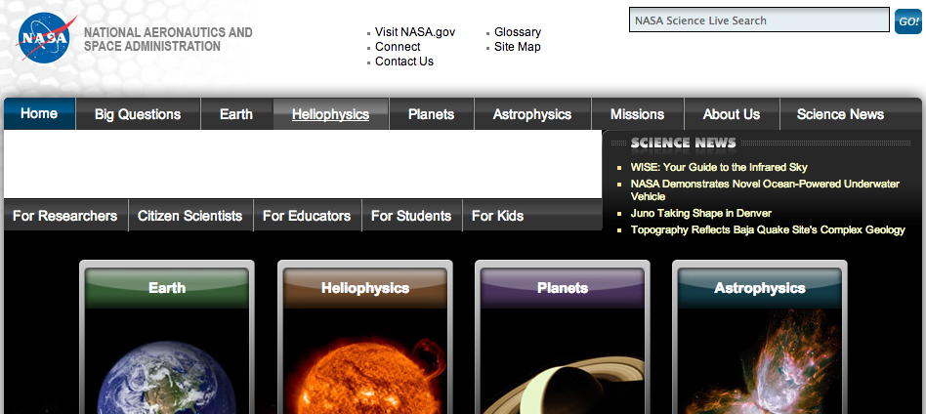
2010:
Combined
Science@NASA,
NASAscience
Lost J-Track 3D
:-(
Notes:
MSFC’s Science@NASA which hosted J-Track 3D ran out of funding
April 2010 merged content into HQ’s NASAscience site: over 10 years of stories.
We lost the applet’s Java .class so J-Track 3D stopped.

Slide 6
Error 404
Notes:
This “Not Found” for J-Track was our biggest error in our web logs, by far.
We never realized how popular it was.
Found Java .class files on the Wayback Machine, decompiled it, got it working.
Tracked down Patrick Meyer and get the original code.

Slide 7
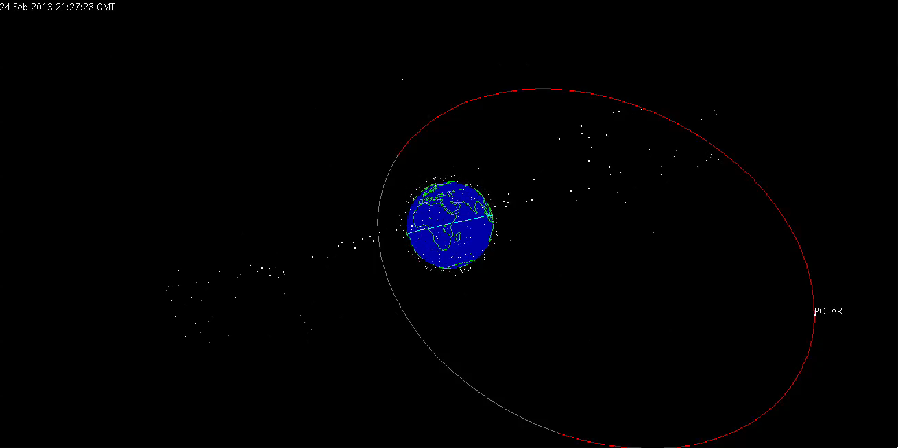
2011 Resurrection of the Dead
Notes:
32second screen cast of J-Track 3D and the POLAR satellite.
100x Realtime.
Cool it’s running again, runs fast on today’s hardware.
Instead of improving the old Java code, we decided to implement using modern approaches.

Slide 8





The Present
Notes:
Java on the client side is getting less and less useful.
Vendor support is waning.
Security threats are increasing.
How can we re-implement it?

Slide 9
Simplified General Perturbation model, Two-Line Element sets
CRRES
1 20712U 90065A 13053.81213084 .00000438 00000-0 19664-3 0 5890
2 20712 017.6798 229.1652 7126906 030.1483 014.4748 02.43899184189834
LANDSAT 8
1 39084U 13008A 13054.33548947 -.00001844 00000-0 -33542-3 0 251
2 39084 98.2410 126.3160 0010813 255.2582 104.7541 14.64913222 1693
ISS (ZARYA)
1 25544U 98067A 13054.33198096 .00043022 00000-0 69361-3 0 2781
2 25544 51.6461 313.8194 0011796 301.9946 162.4257 15.52412156817027
Notes:
SGPs predict the effect of the Earth, Sun and Moon on satellite orbits. TLE examples: Red: name; blue: satellite number, green: international designator (YY+Number+Fragment); yellow: year; orange: day last sighted. The rest are parameters of the orbit, for example, pink indicates revolutions per day.

Slide 10

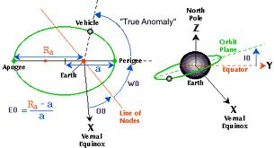
Math’s hard, let’s go shopping!
Notes:
The math is hard.
The SGP code is dense.
We could do calculations on server and stream to browsers, but…
if we have 1000 satellites and a million browsers, we’re going to crush the server.

Slide 11
JavaScript is Fast Fast Enough??
Notes:
Can we do it in the Browser itself?
JavaScript turns out to be pretty fast.
Graph based on http://blog.famzah.net/2010/07/01/cpp-vs-python-vs-perl-vs-php-performance-benchmark/

Slide 12
JavaScript implementation
67,000 calculations/second
Notes:
I translated the SGP algorithm from a MATLAB implementation to JavaScript.
Performances of end-to-end tests was surprisingly good.
Hopefully good enough.
We can now calculate the position of satellites from the TLEs.
(Safari on 3-year old MacBook Pro running almost 60,000 Qunit tests exercising all the math.)

Slide 13
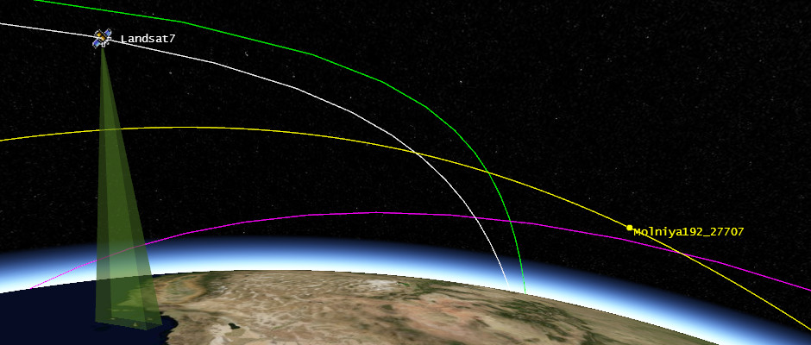

Visualization
Notes:
We have the positions, but how do we display them to users?
At last year’s NASA Open Source Summit, I ran into some folks from AGI who told me about work they were doing in satellite visualization. I
All JavaScript, using WebGL, running in the browser – perfect.
It’s open source, hosted in GitHub, and actively developed – currently at Beta 13.

Slide 14
Compatibility: WebGL, JavaScript
Desktop | Android | iOS
FireFox: yes Chrome: yes Safari: yes, if WebGL enabled IE: yes, with ChromeFrame | FireFox: yes Chrome: ? Default Browser: no | All: disabled by Apple (except for advertising partners)
Notes:
Will it run in all browser?
Depends on WebGL support.
Older hardware may not support it either (my 3-year old Android phone doesn’t)
Some hardware has driver issues: MacAir doesn’t show the star-field.
Support is improving – aim for the future rather than the past.

Slide 15

Demo
http://science.nasa.gov/iSat
Notes:
We’re just using screencasts here to show some of the interactivity.
Try it yourself!
(QR code from phone: phone may not run app well, try it on a desktop)

Slide 16
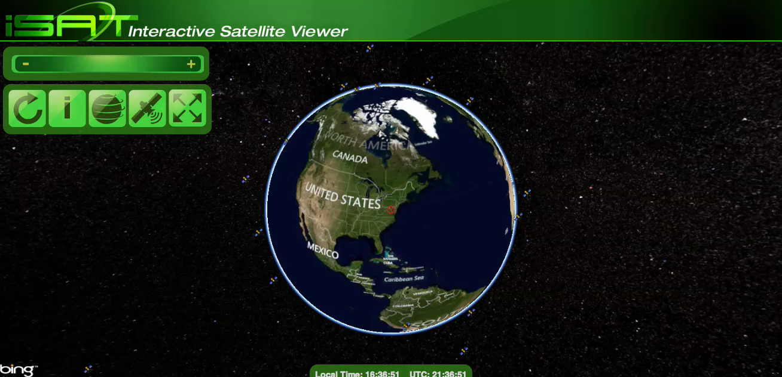
Demo 1: Zoom, Rotate, Motion
Notes:
Reset: fix orientation, centers on your geolocation.
Info: on basic usage.
Zoom out: show outlier satellites.
Rotate: show 3D with stars (looks great on full-screen)
Zoom in: show satellite flying over land in real time.

Slide 17

Demo 2: Satellite Info
Notes:
Hover: show name
Click: center on satellite; shows orbits, rotate to view.
Location pane; links to Science, NSSDC.

Slide 18
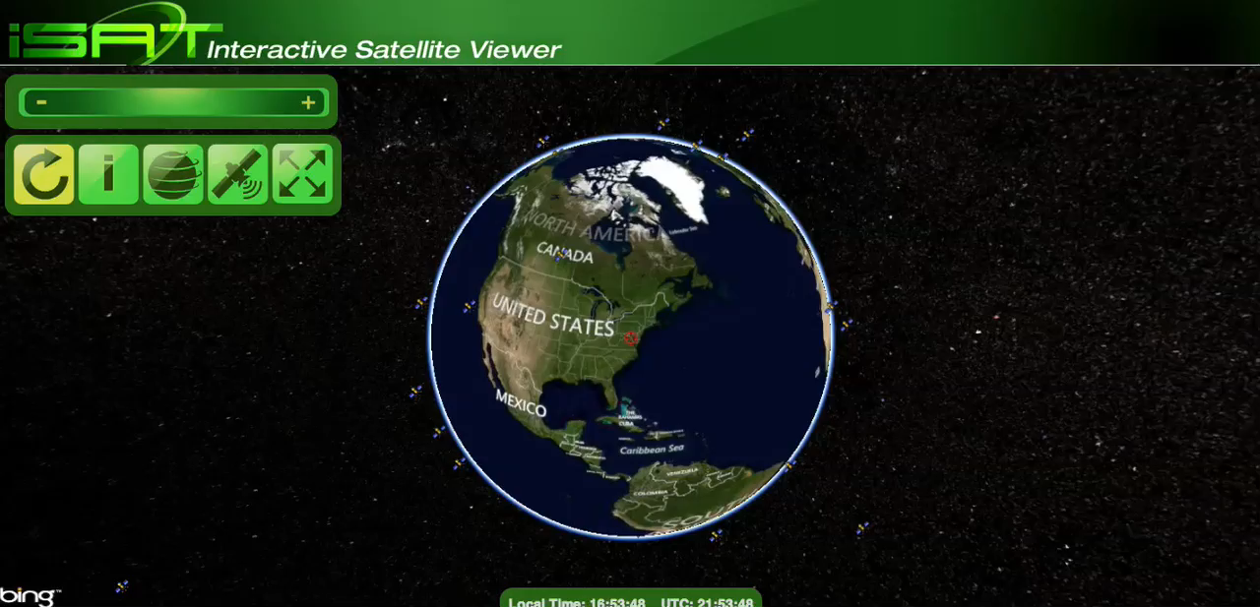
Demo 3: Globe, Satellite pickers
Notes:
Map tile provider: Bing, OpenStreetMap, ESRI, flat file for offline; back to ESRI. (pick a satellite to get orbit)
Projection: spherical; flat; “2.5D” flat map with satellites above.
Satellite picker:
- NASA Science, POLAR
- Geosynchronous, same radius, on Equator, hole over ocean, dense over the Americas.

Slide 19
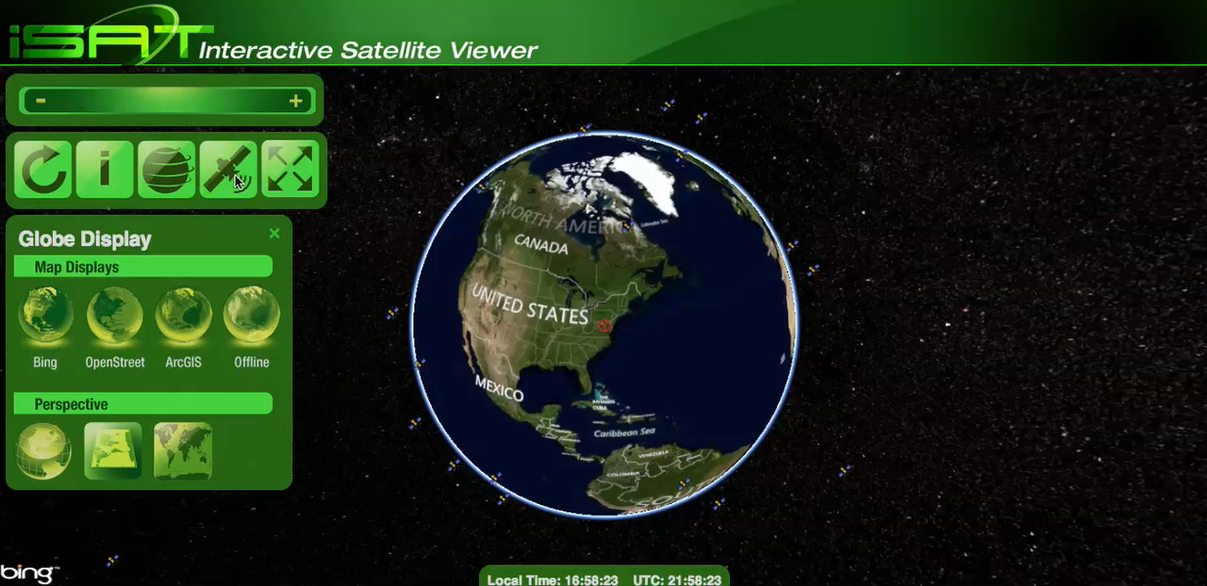
Demo 4: Space Junk
Notes:
1997 Chinese test of satellite killer destroyed Fengyun-1C.
Over 2000 golf-ball sized pieces of debris, over 150,000 particles.
All moving in different directions.
Still in orbit, posing a hazard to others.

Slide 20
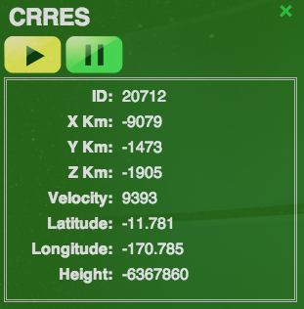
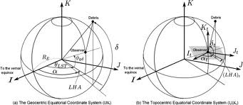
v1.0: Missing and Mis-Features
Notes:
Bad location due to coordinate transformations.
Tighter integration with Science.nasa.gov and NSSDC.
Clock: x100, x1000 realtime
Better Android support in latest Cesium release.
Touch support for handheld devices.

Slide 21
Shout-outs
Josh Finnie, Colleen Kaiser, Jenny Mottar: code, UI, UX, graphics
AGI, Cesium community: awesome virtual globe and map engine
Ruth Netting: NASA SMD support and encouragement
NASA, SXSW: allowing me to debut iSat here
Notes:
Team who helped build it
Cesium community for virtual globe engine
SMD and NASA for supporting the development
SXSW for letting me debut it here

Slide 22
Play with it!
http://science.nasa.gov/iSat
@shentonfreude
chris.shenton@nasa.gov

